Slide 1
Digital-to-Analog Conversion
To send the digital data over an analog media, it needs to be converted into analog.
Digital-to-Analog Conversion
When data from one computer is sent to another via some analog carrier, it is first converted into analog signals. Analog signals are modified to reflect digital data.

Slide 2
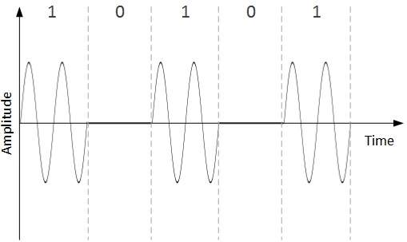
An analog signal is characterized by its amplitude, frequency, and phase. There are three kinds of digital-to-analog conversions:
Amplitude Shift Keying
In this conversion technique, the amplitude of analog carrier signal is modified to reflect binary data.
When binary data represents digit 1, the amplitude is held; otherwise it is set to 0. Both frequency and phase remain same as in the original carrier signal.

Slide 3
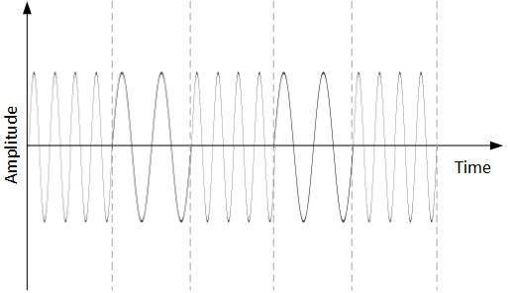
Frequency Shift Keying
In this conversion technique, the frequency of the analog carrier signal is modified to reflect binary data.(10101)

Slide 4
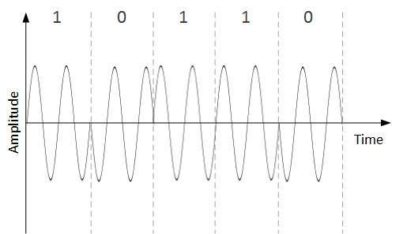
Phase Shift Keying
In this conversion scheme, the phase of the original carrier signal is altered to reflect the binary data.

